Slide 1
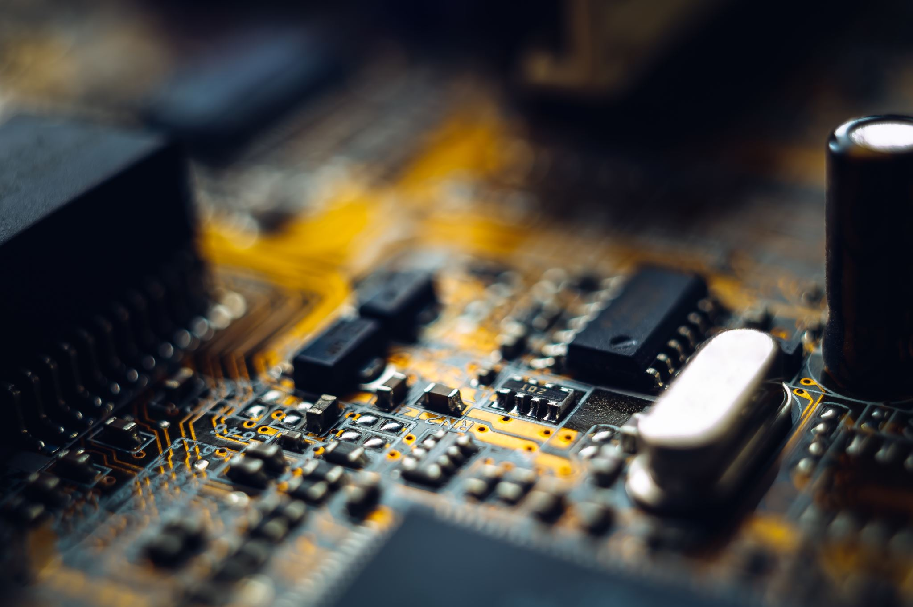



Smart Home
By Team Exemplary

Slide 2
Architectural Overview – Neaz Mahmud
Techniques and Method – Tasawar Siddiquy & Asm Nurussafa.
Slide Design – Tasawar Siddquy & Neaz Mahmud
Smart Device’s Function – Asm Nurussafa & Neaz Mahmud

